Slide 1


EXPLORING STUDENT’S VIEWS ON JOHN BROWN UNIVERISTY ATHLETICS
Prepared for:
Robyn Daugherty
Director of John Brown University Athletics
Prepared by:
Jose Almanza

Slide 2
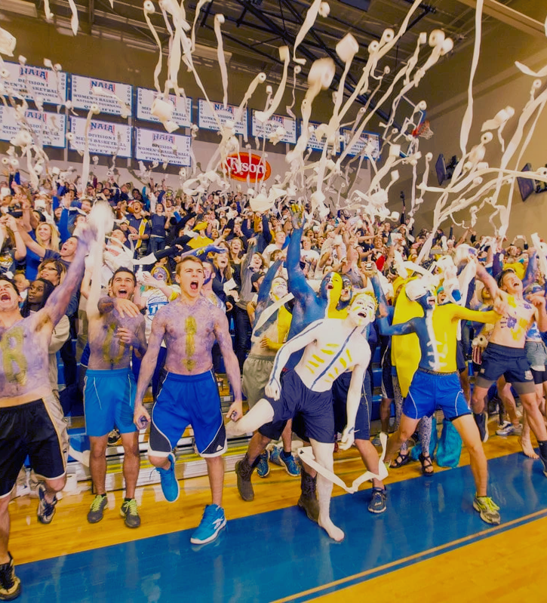

PROBLEM STATEMENT
John Brown University Athletic Department wants to increase the attendance and involvement of TUG students with Athletics activities (games).
Presented By : Jose Almanza

Slide 3
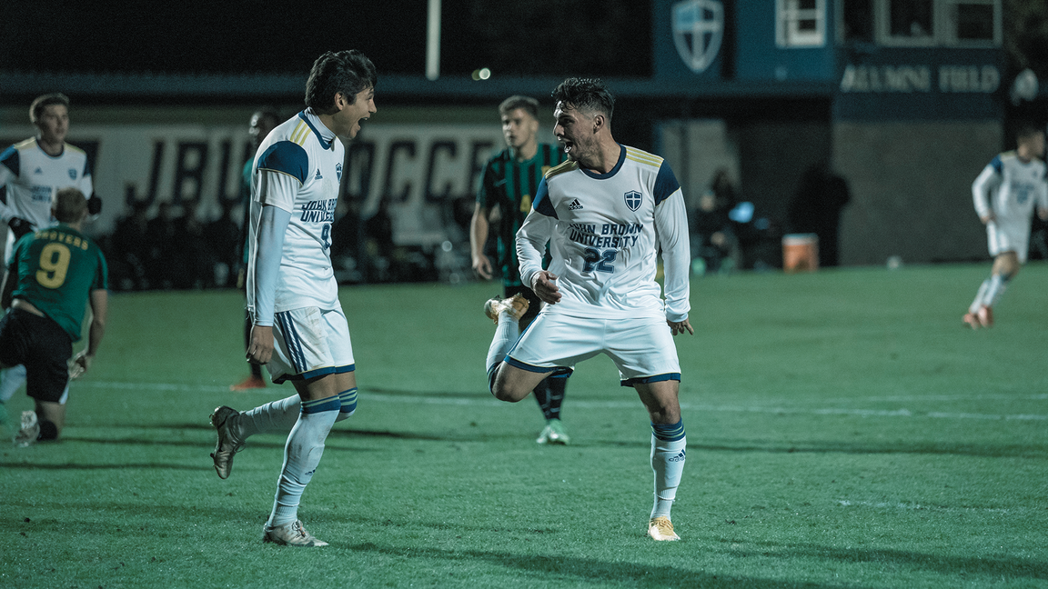
RESEARCH DESIGN
AND
DATA COLLECTION
DESIGN
METHODS
  STUDY: QUANTITATIVE
  INSTRUMENT: SURVEY
  PLATFORM: MICROSOFT FORMS
  SAMPLING: RANDOM
  SAMPLE SIZE:
105
  INVITATION:
EMAIL
Presented By : Jose Almanzae

Slide 4
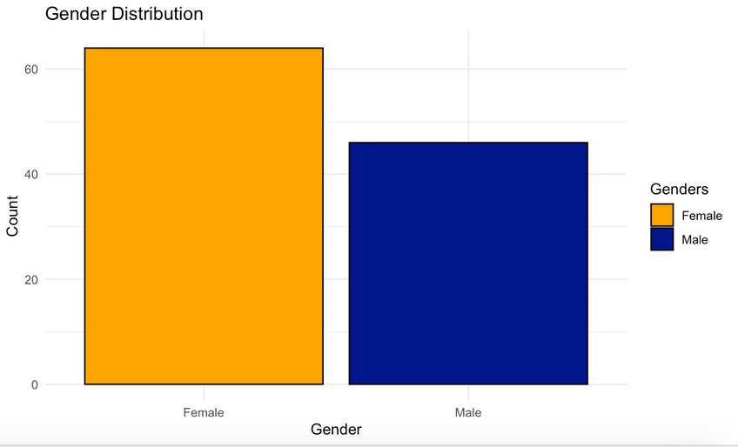
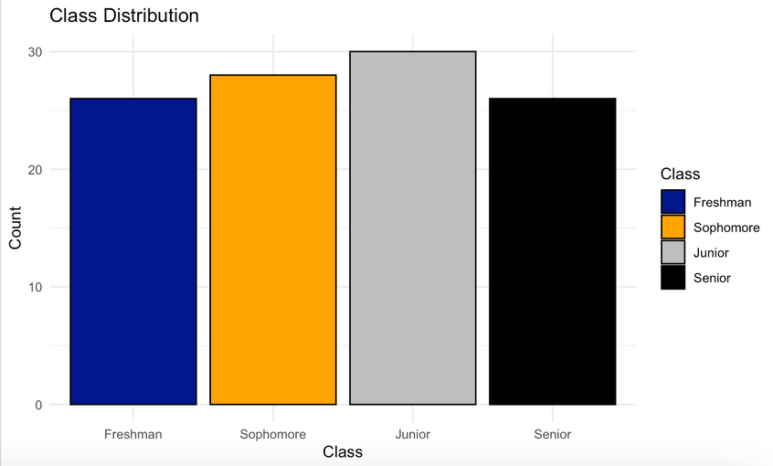
FINDINGS
GENDER DISTRIBUTION
FEMALE: 58.2%
MALE: 41.8%
  Food Incentives, Knowledge of the Sport being, and Performance influence over the decision to attend games.
  Males show higher agreement on performance impact.
  When asked about perception and its effect “fiends” and “good” two of the most recurrent words
LIMITATIONS
CLASS DISTRIBUTION
FRESHMEN: 23.6%
SOPHOMORE: 25.5%
JUNIOR: 27.3%
SENIOR: 23.6%
  Inability to meet objectives
  Lack of precise understanding of variables' impact on attendance decisions.
Presented By : Jose Almanza

Slide 5
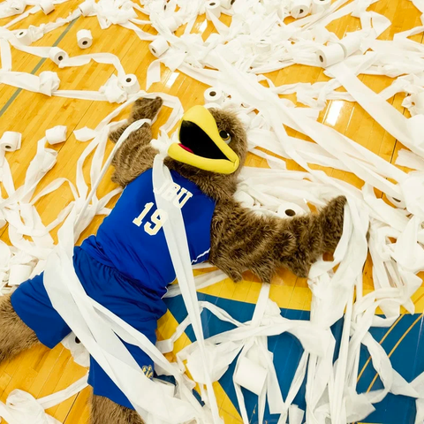

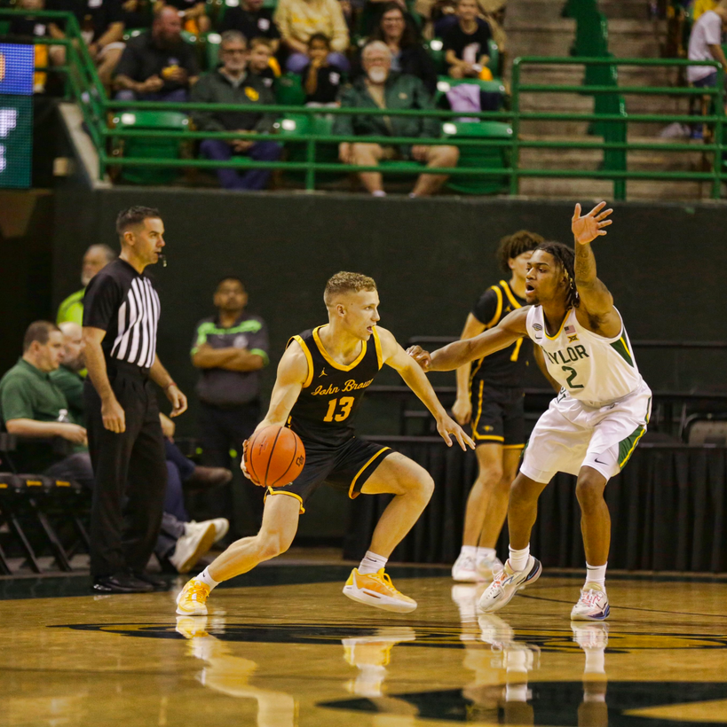
RECOMMENDATIONS
RE-RUN RESEARCH FOR OBJECTIVE ALLIGMENT
UNDERSTAND EFFECT OF THE VARIABLES OVER DESIRE
ATHLETES AS AMBASSADORS
Presented By : Jose Almanza

Slide 6
FUTURE RESEARCH
BETTER COMMUNICATION WITH CLIENT
VARIABLE EXPANSION
ASK THE RIGHT QUESTIONS
HYPOTHESIS-OBJECTIVE RELATIONSHIP
Presented By : Jose Almanza

Slide 7
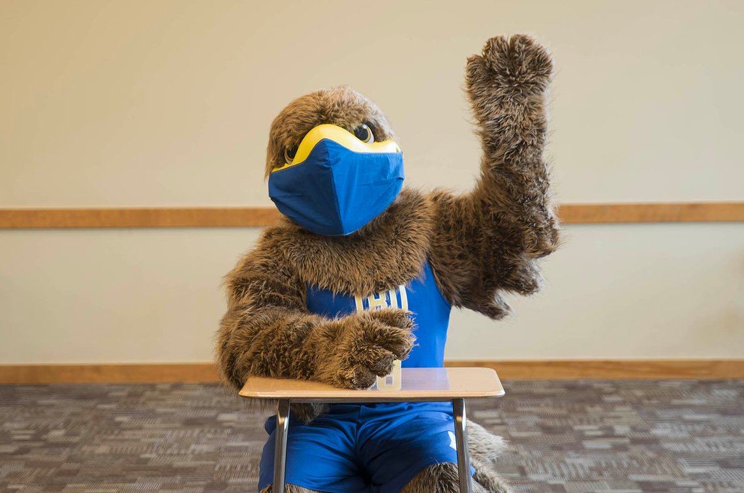
THANKS!
Q&A
Presented By : Jose Almanza

